Slide 1
PayPal Notebooks
Data science and machine learning at scale, powered by Jupyter
Romit Mehta, Praveen Kanamarlapudi • August 24, 2018

Slide 2
Agenda
Introductions
PayPal Key Metrics and analytics ecosystem
Enabling data science at scale
Jupyter platform
PPMagics
Collaboration and deployment
Data access with Gimel
Big data enhancements
Open source plans

Slide 3
Introductions
Romit Mehta
Praveen Kanamarlapudi
Product manager, data processing products at PayPal
20 years in data and analytics across networking, semi-conductors, telecom, security and fintech industries
Data warehouse developer, BI program manager, Data product manager
romehta@paypal.com
https://www.linkedin.com/in/romit-mehta
Software engineer, Big data platform engineering at PayPal
5 years in building distributed and scalable applications
PayPal Notebooks lead engineer
pkanamarlapudi@paypal.com
https://www.linkedin.com/in/praveenkanamarlapudi

Slide 4
PayPal Key Metrics

Slide 5
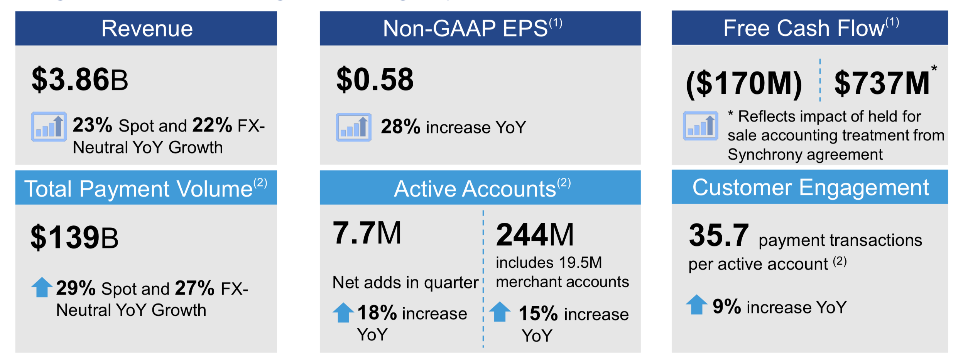
PayPal Customers, Transactions and Growth
From: PayPal’s Q2 2018 Investor Update

Slide 6
PayPal Analytics Ecosystem

Slide 7
PayPal Big Data Platform
13 prod clusters, 12 non-prod clusters
GPU co-located with Hadoop
75,000+ YARN jobs/day
160+ PB Data
One of the largest Aerospike, Teradata, Hortonworks and Oracle installations
Compute supported: MR, Pig, Hive, Spark, Beam

Slide 8
Developer
Data scientist
Analyst
Operator
User Experience and Access
Logging
Gimel SDK
Notebooks
R Studio
BI tools
Compute Framework and APIs
Gimel Data Platform
Monitoring
Application Lifecycle Management
Data API
PCatalog
Alerting
Infrastructure services leveraged for elasticity and redundancy
Security
Multi-DC
Predictive resource allocation
Public cloud

Slide 9
PayPal Notebooks Platform
Zeppelin
Individual use
Jupyter deployed
PayPal Notebooks
Beta
PayPal Notebooks
Generally Available
PayPal Notebooks Today
Q2 2017
Q3 2017
~50 users
Feb 2018
~100 users
~1,300 users
SQL, Spark/PySpark, Python, R
2016

Slide 10
Demo
PayPal Notebooks in action

Slide 11
Two customer segments
Analyst
Data scientist
Tracking payments by geo
POC with static (csv) data
Collaborate with team
Visualize results
Switch to live data
Deploy/productionalize
Build and train models
Fetch data
Prep/cleanse data
Use algorithm to build model
Tweak model
Finalize model
11

Slide 12
Jupyter deployed as a platform
From Jupyter to PayPal Notebooks

Slide 13
PayPal Notebooks Platform
Highly available JupyterHub
Grid of JupyterHub hosts
Highly available and distributed
SSO + 2FA integration
Kerberos + LDAP integration
Standalone Docker
Container image with all PPExtensions
Required to deploy across various security zones at PayPal
Foundation for open sourcing PPExtensions
GPU integration
Enable deep learning through notebooks
Distributed TensorFlow training enabled with dynamic GPU resource management

Slide 14
PPExtensions Set of extensions to improve user experience and reduce time to market

Slide 15
PPMagics
%hive, %teradata
Query data from Hive (or Teradata)
Query data from Presto
Publish to Tableau
Insert data using csv/dataframes
%run, %run_pipeline
Query data from Spark Thrift Server
%sts
Includes progress bar for SQL execution
Publish to Tableau
Run any notebook from another notebook
Run multiple notebooks in parallel
%csv
Run SQL on csv files
%presto
Execute a pipeline of notebooks

Slide 16
Collaboration and deployment
Github sharing
Project collaboration
Push notebook to common org-wide repo
View full fidelity notebook on Github
Share link to notebook instead of .ipynb file or code snippets
Share notebook to personal and team repos
Resolve conflicts between remote and local notebooks with nbdime
Tableau publishing
Deployment/scheduling
Seamlessly publish to Tableau
Download TDE to use Tableau Desktop, or directly publish as a data source
Integrate with Airflow
Set up frequency, alerts, optionally push to Github after every run
Add Celery executor for scalability

Slide 17
Gimel Unified Data API to access any data store

Slide 18
Simplified access to big data systems with GSQL
Single unified data API to access any data store
SQL capabilities against any data store
Switch between interactive, batch and streaming modes
Centralized metadata catalog (PCatalog) to abstract the physical complexities of accessing data
Open sourced in April: gimel.io
Integrated with Jupyter through GSQL
Dataset browser in notebooks powered by PCatalog

Slide 19
Big data and machine learning

Slide 20
Big data and machine learning
Apache Spark
Apache Livy
Tensorflow
Updates to sparkmagic
Enabled progress bar for Spark jobs
Enabled SQL session support with Apache Livy
Integrated Tensorflow for distributed model training
Enabled Tensorflow with GPU

Slide 21
PayPal Notebooks Open Source Plans

Slide 22
Open sourcing PPExtensions
PPMagics: available now
Gimel: available now
Airflow integration
Github sharing
Project collaboration
Tableau integration
Config UI
Dataset browser
Pipelines
Data Science Workbench

Slide 23
Open source links and info
Install | pip install ppextensions
Github | http://ppextensions.io
Google Group | https://groups.google.com/d/forum/ppextensions
Slack | https://ppextensions.slack.com
Gimel | http://gimel.io

Slide 24
Q&A

